Slide 1

Chinook Music Store Analysis
By:
Ranajoy Dutta

Slide 2

AGENDA
Problem statement
Data overview
observation
Strategies and recommendations
conclusion

Slide 3
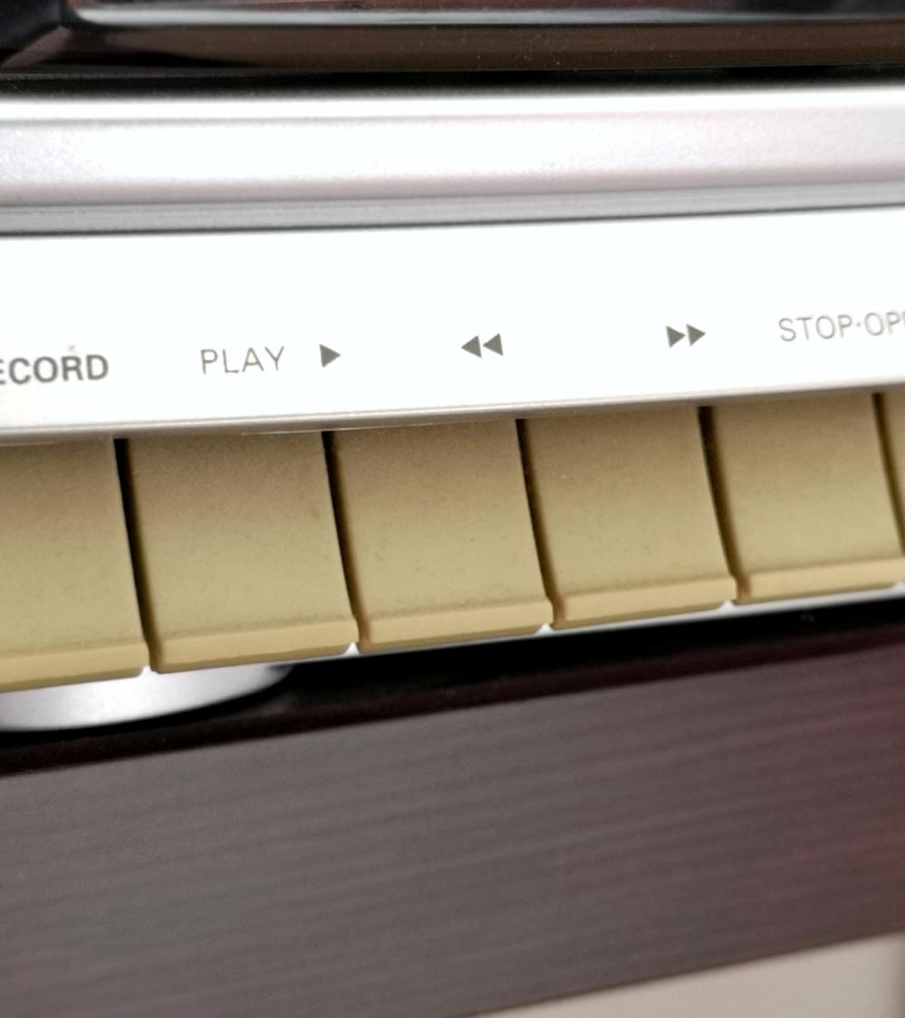
Problem Statement
You are hired as a data analyst at Chinook, and your objective is to analyze music record sales data to gain insights and make recommendations for the company's strategy in the physical music market.

Slide 4

Data Description
Table 1: customer
• customer_id: Unique identifier assigned to each customer.
• first_name: The given name or first name of a customer.
• last_name: The surname or family name of a customer.
• company: The name of the company associated with a customer.
• address: The street address of a customer's location.
• city: The city where a customer is located.
• state: The state or province where a customer is located.
• country: The country where a customer is located.
• postal_code: The postal or zip code of a customer's address.
• phone: The phone number of a customer.
• fax: The fax number associated with a customer.
• email: The email address of a customer.
• support_rep_id: The employee ID of the support representative assigned to a customer.
Table 2: employee
• employee_id : Unique identifier assigned to each employee.
• last_name : Last Name of the Employee.
• first_name : First Name of the Employee.
• title : Designation of the Employee.
• reports_to: employee id of the person the Employee reports to.
• birthdate : Date of Birth of the Employee.
• hire_date : Date the employee was hired on.
• city : The city where the employee lives.
• state : The state where the employee lives.
• Country: Nationality of the employee.
• postal_code: Employee postal code.
• Phone: The phone number of employee.
• Fax: Fax number of employee.
• Email: Email of employee.

Slide 5
Data Description
Table 3: invoice
• invoice_id: Unique identifier assigned to each invoice.
• customer_id: The customer ID associated with the invoice.
• invoice_date: The date when the invoice was generated or issued.
• billing_address: The street address used for billing purposes.
• billing_city: The city used for billing purposes.
• billing_state: The state or province used for billing purposes.
• billing_country: The country used for billing purposes.
• billing_postal_code: The postal or zip code used for billing purposes.
• total: The total amount due on the invoice.
Table 4: invoice_line
• invoice_line_id: Unique identifier assigned to each line item on an invoice.
• invoice_id: The invoice ID to which the line item belongs.
• track_id: The ID of the track or product included in the line item.
• unit_price: The price per unit for the line item.
• quantity: The quantity of units for the line item.
Table 5: playlist:
• playlist_id: Unique identifier assigned to each playlist.
• name: The name or title of the playlist.
Table 6: playlist_track:
• playlist_id: The ID of the playlist to which the track belongs.
• track_id: The ID of the track included in the playlist.

Slide 6
Data Description
Table 7: track
• track_id: Unique identifier assigned to each track or song.
• name: The title or name of the track.
• album_id: The ID of the album to which the track belongs.
• media_type_id: The ID of the media type associated with the track.
• genre_id: The ID of the genre associated with the track.
• composer: The name of the composer or artist who composed the track.
• milliseconds: The duration of the track in milliseconds.
• bytes: The file size of the track in bytes.
• unit_price: The price per unit for the track.
Table 8: artist
• artist_id: Unique identifier assigned to each artist.
• name: The name of the artist.
Table 9: album
• album_id: Unique identifier assigned to each album.
• title: The title or name of the album.
• artist_id: The ID of the artist associated with the album.
Table 10: media_type
• media_type_id: Unique identifier assigned to each media type.
• name: The name or description of the media type (e.g., MPEG audio file, AAC audio file).
Table 11: genre
• genre_id: Unique identifier assigned to each genre.
• name: The name or description of the genre (e.g., rock, pop, classical).

Slide 7

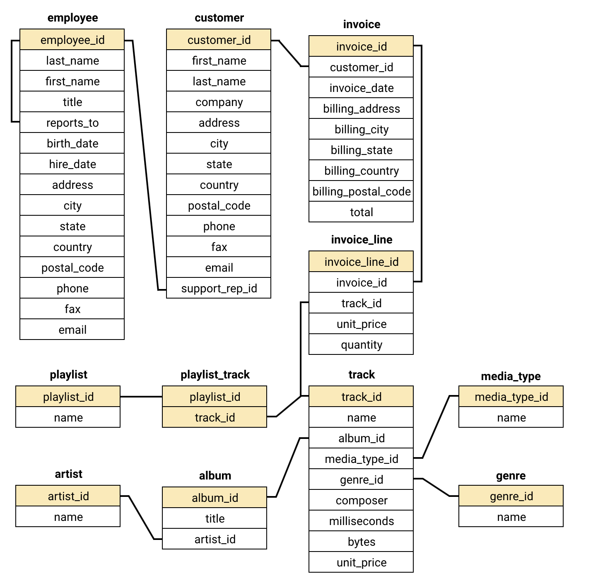
Database Schema

Slide 8

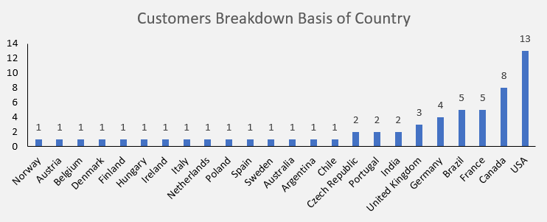
Customers in Countries
• USA has the highest number of customers 13 that is 22% of total customers are from USA followed by Canada with 8 customers.
• Norway, Austria, Belgium, Denmark, Finland, Hungary, Ireland, Italy, Netherland, Poland, Spain, Sweden Australia, Argentina and Chile has the lowest number of customers only 1.

Slide 9

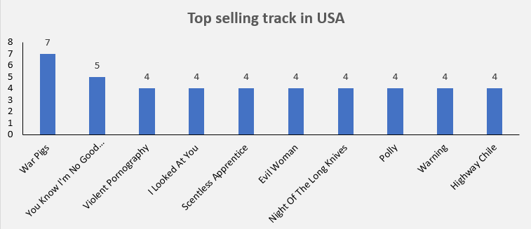
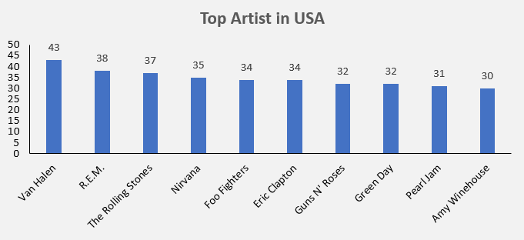
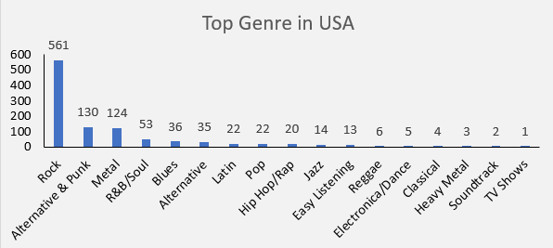
Top Track, Artist & Genre in USA
• Top selling Track in USA is “War Pigs” followed by “You Know I’m No Good”.
• Other Tracks are equally popular in USA.
• Top Artist in USA is “Van Halen” followed by “R.E.M”.
• Other Artists are also quite popular in USA.
• Most famous Genre in USA is “Rock” followed by “Alternative & Punk” and “Metal”.
• All other genres not much preferred in USA.

Slide 10

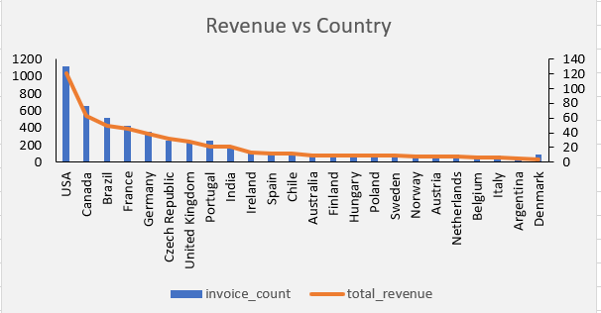
Revenue in Countries
• USA has the highest revenue among all the countries with highest number of sales.
• We can see a rapid decline in revenue in other countries as well as decrease in sales.

Slide 11

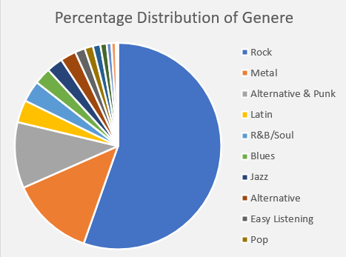
Percentage Distribution of Genre
• More than 55% of customer like genre “Rock” over all other genres.
• “Metal” and “Alternative & Punk” genres are nearly liked by customers equally.
• Least popular genres are Drama and TV Shows which is liked by only 0.04% and 0.02% of customers.

Slide 12

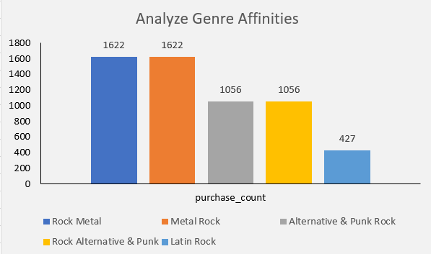
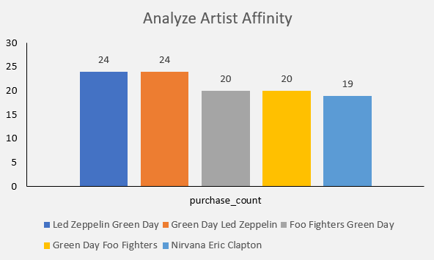
Product Affinity Analysis
Genre Affinities:
• Rock and Metal genres are frequently bought together followed by Alternative & Punk and Rock genres are also preferred by customers they bought together.
Artist Affinities:
• Led Zeppelin and Green Day artists are frequently bought together also customer bought Foo Fighters with Green Day are also preferred by customers they bought together.

Slide 13
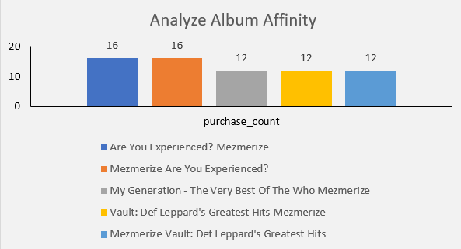
Product Affinity Analysis
Album Affinities:
• Albums “Are You Experienced?” and “Mezmerize” are frequently bought together also customer bought albums “My Generation – The Very Best Of The Who and Vault: Def Leppard’s Greatest Hits” with “Mezmerize” are also preferred by customers they bought together.

Slide 14
Strategies and Recommendations
Customer Based:
• Expand promotion over high populated countries like India, United Kingdom, Spain, Italy and Australia.
• Increase customer acquisition efforts through targeted marketing and advertising campaigns to grow the customer base and boost revenue.
• Re-engage inactive customers by offering discounts and promotions to improve customer retention and drive higher engagement.
Product Based:
• Broaden the music catalog to include region-specific preferences, fostering a more diverse and global user base.
• Diversify the promotion of music genres beyond current successes, like newly launched tracks, catering to a wider audience and increasing potential revenue streams.
• Add new type of genre and new languages which can make a trending sector in some regions.

Slide 15

Conclusion
• Top artist is Van Halen and the country with the highest customer base is USA.
• Long-term customers exhibit higher purchase frequency and spending, indicating strong loyalty.
• Rock music dominates globally, with exceptions like Brazil showing a preference for Alternative & Punk and Metal.
• Genres, Tracks and Artists with the highest affinity should be promoted together by running combo offers and selling them together as pairs.
• Feedback must be taken from the customers to make the needful changes and increase the userbase.

Slide 16

Thank You
Ranajoy Dutta
ranajoy8004@gmail.com

